Slide 1
Consultant Property Management and Demolition – Lessons Learned
Amy Ishmael, KYTC
Mark Askin, Strand Associates, Inc.®

Slide 2
BSB Update
72 Parcels total, 53 active
41 Parcels purchased, 12 submitted for condemnation
14 parcels require demolition, 8 active

Slide 3
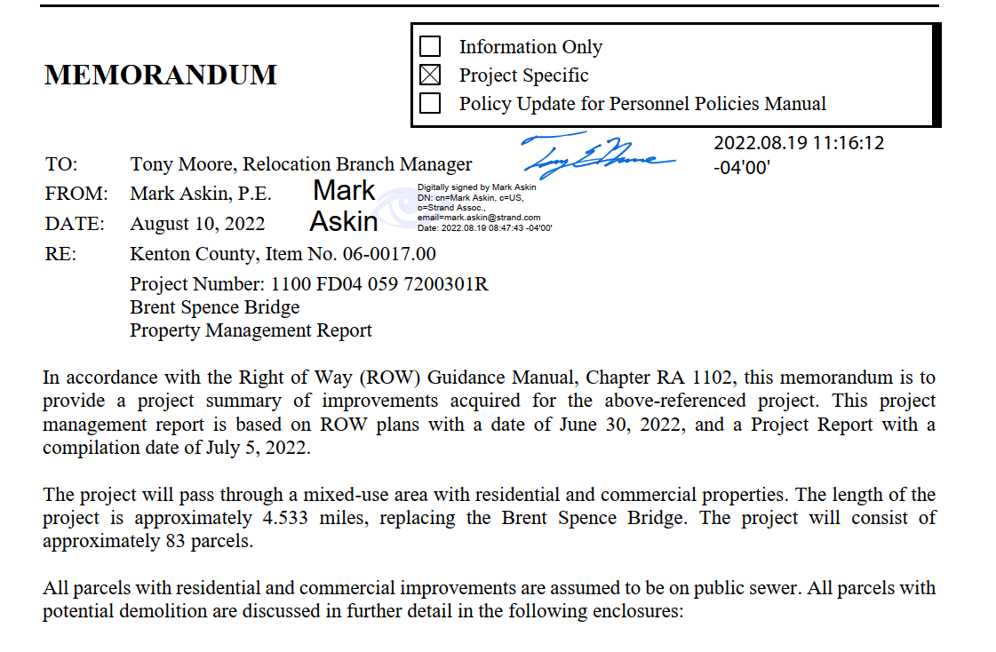
Property management report
Memo
Project summary of improvements
Improvements to be removed photographs

Slide 4
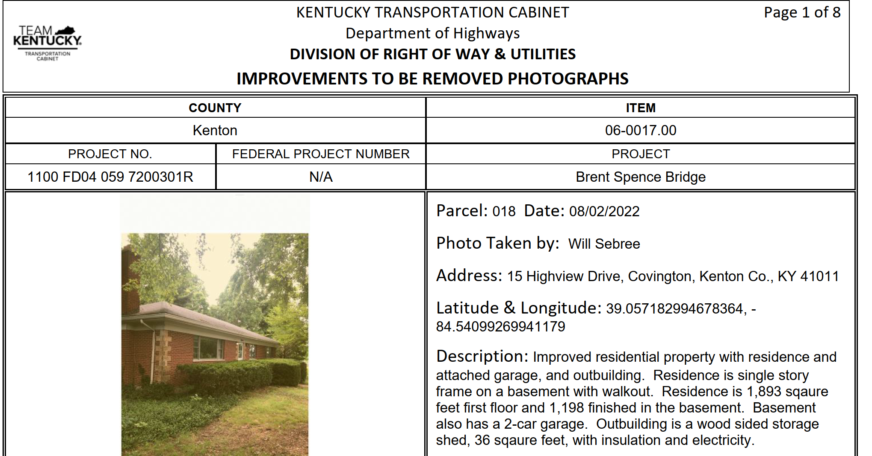
Property management report

Slide 5
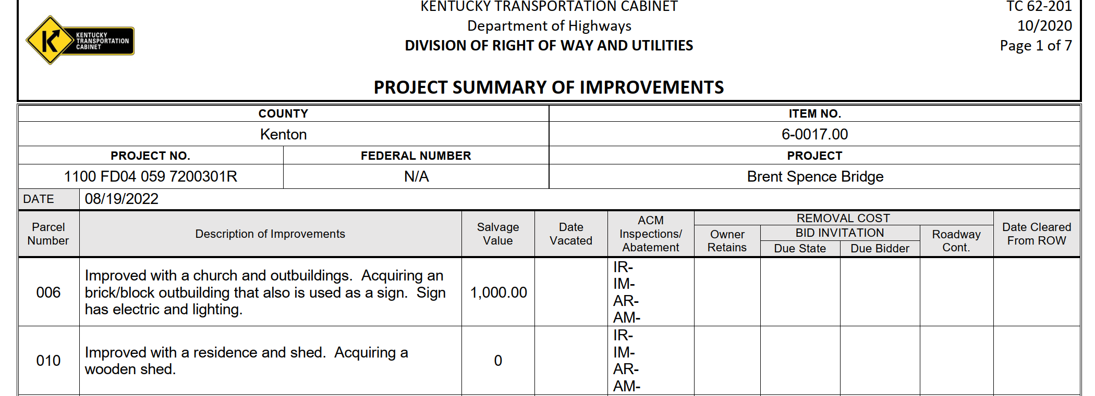
Property management report

Slide 6
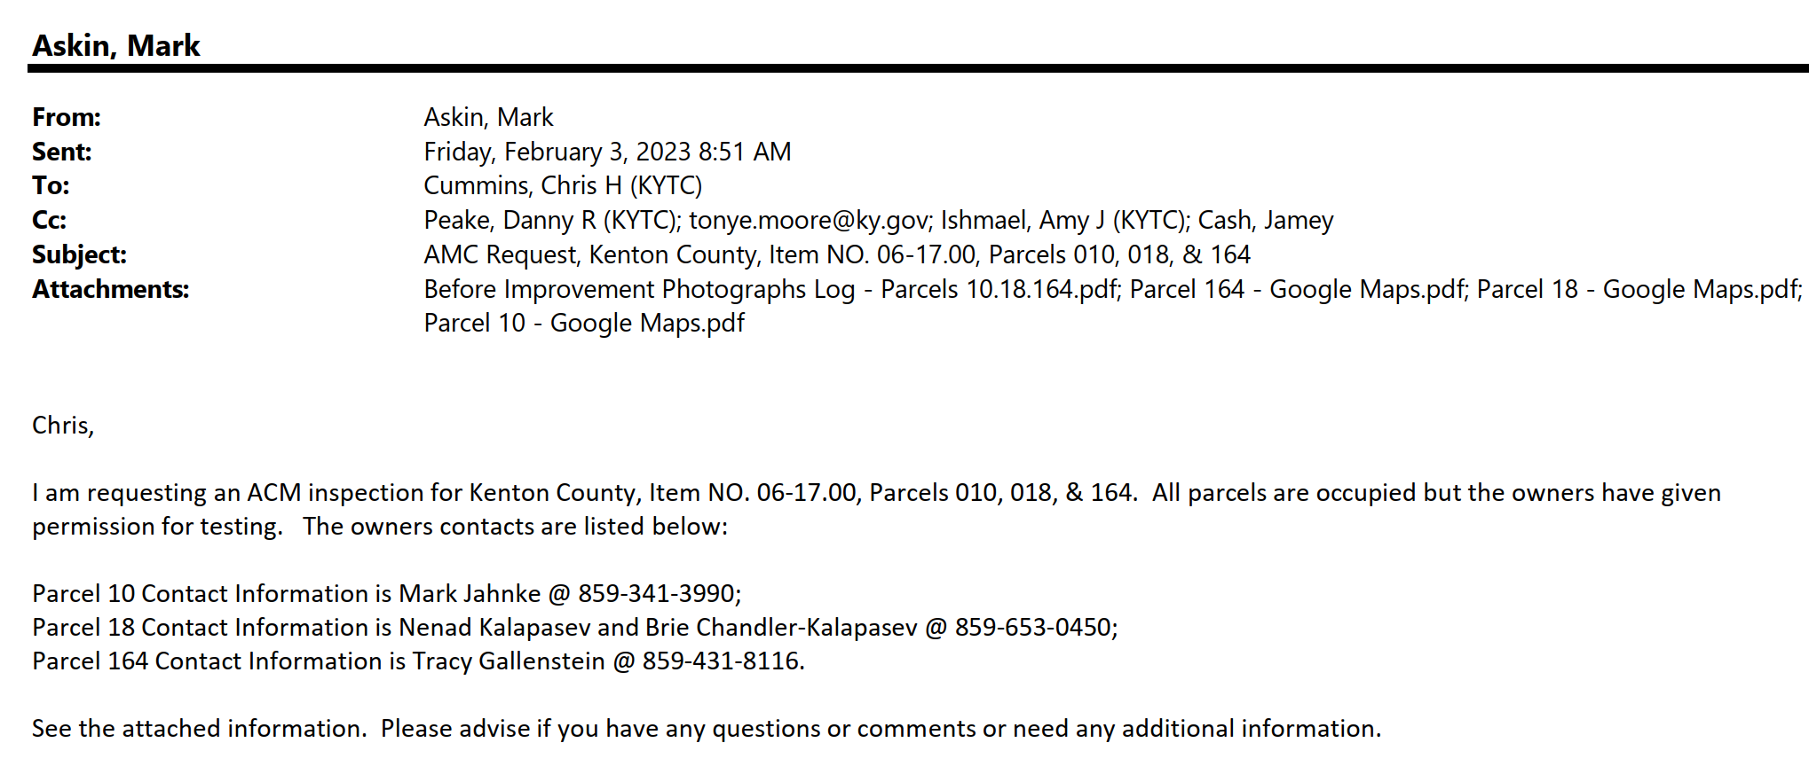
ACM testing
Property is acquired or right of entry is obtained
Request Asbestos Containing Material testing (ACM)

Slide 7
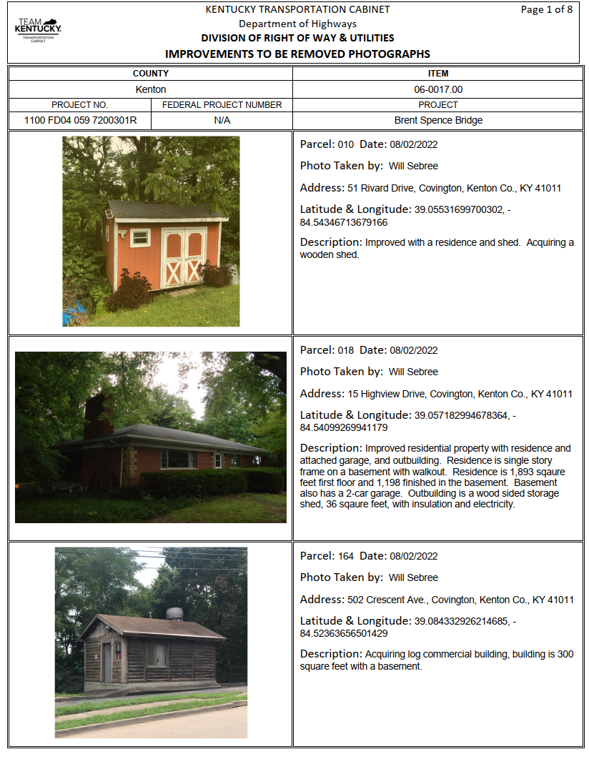
ACM Testing

Slide 8
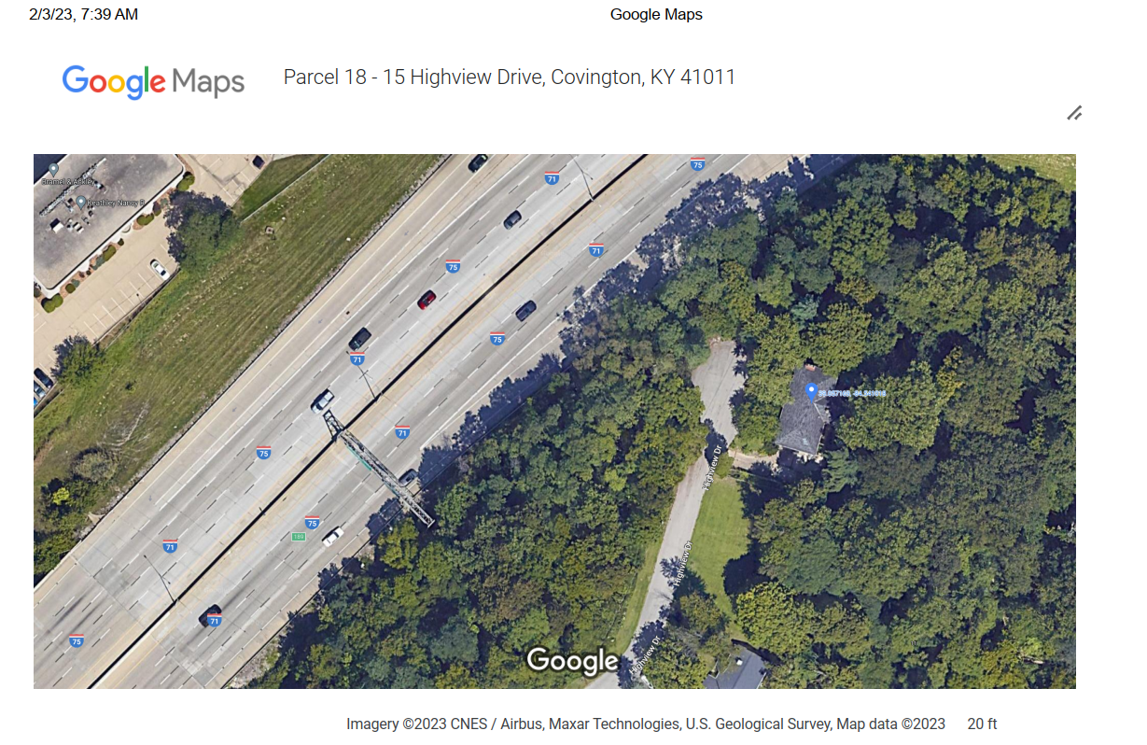
ACM testing

Slide 9
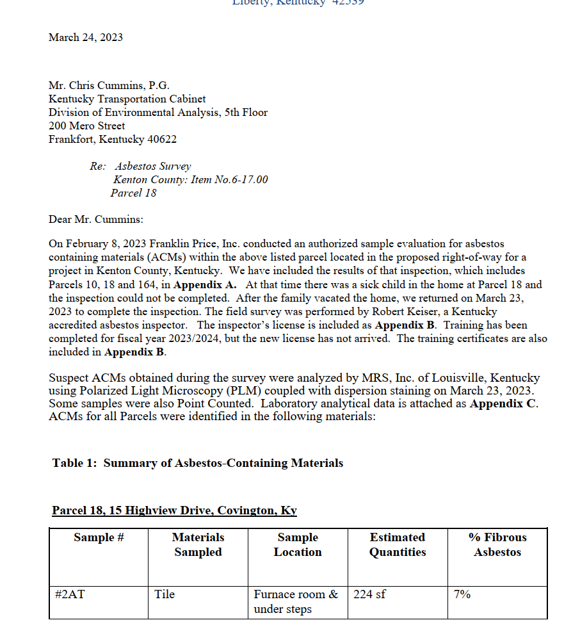
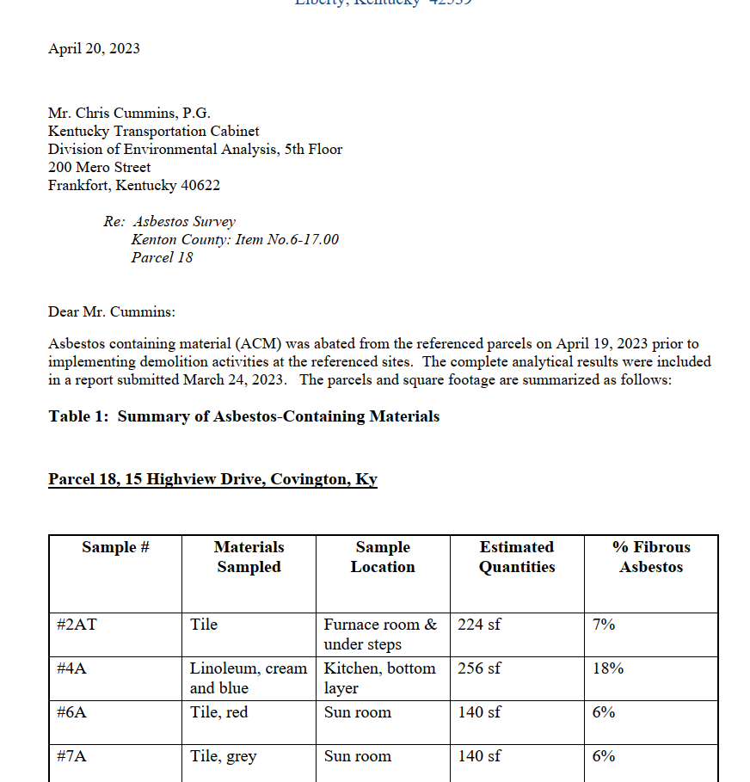
ACM Testing Complete
If test results are positive, have asbestos abated from property!

Slide 10
Utilities
Agent, PM, and Supervisor verify utilities have been disconnected by the owners
This doesn’t clear the site!
Contact the utility to have services removed or plugged
LESSON LEARNED No. 1 – Demolition was delayed on project because utilities were disconnected but not removed

Slide 11
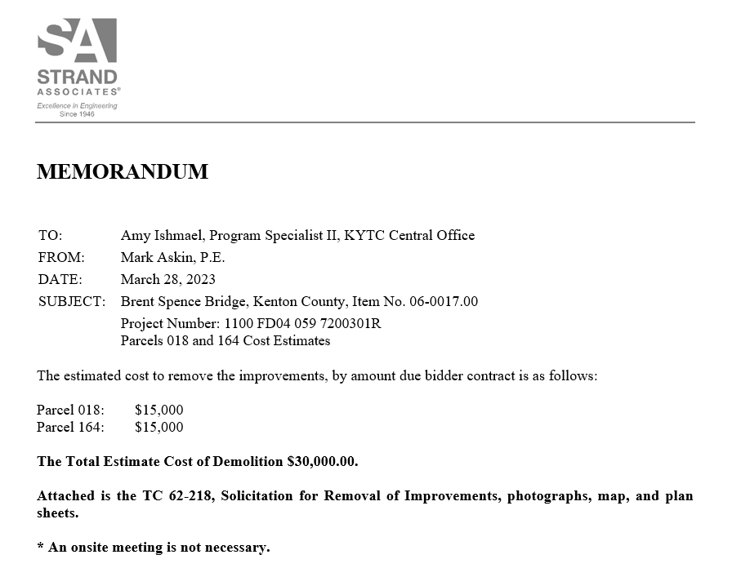
Cost Estimate for Demolition
Send Memo to KYTC for approval

Slide 12
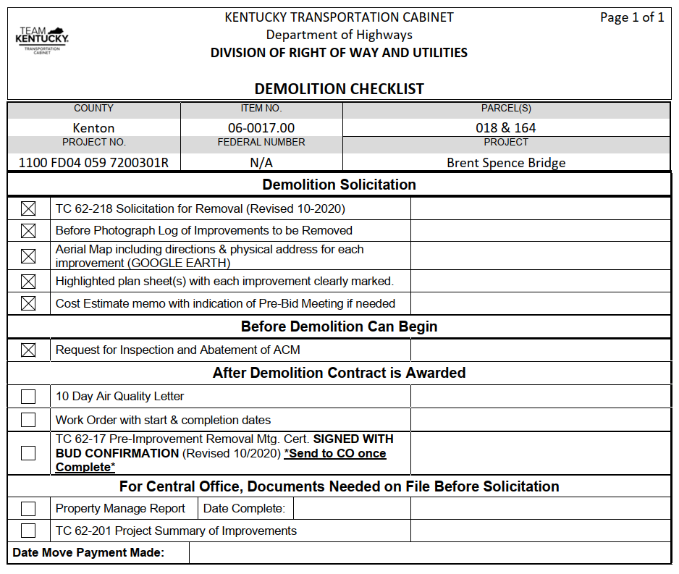
Demolition solicitation
Demolition Checklist
Solicitation for removal of improvements
Create a “Before” photo log
Aerial location maps
Project plans
Cost estimate

Slide 13
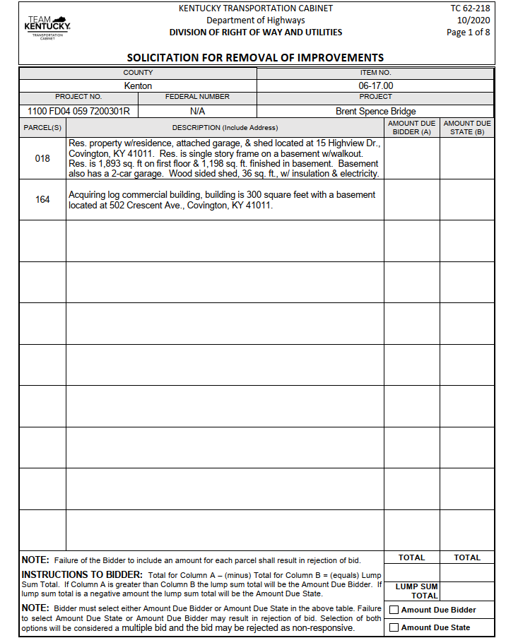
Demolition solicitation

Slide 14
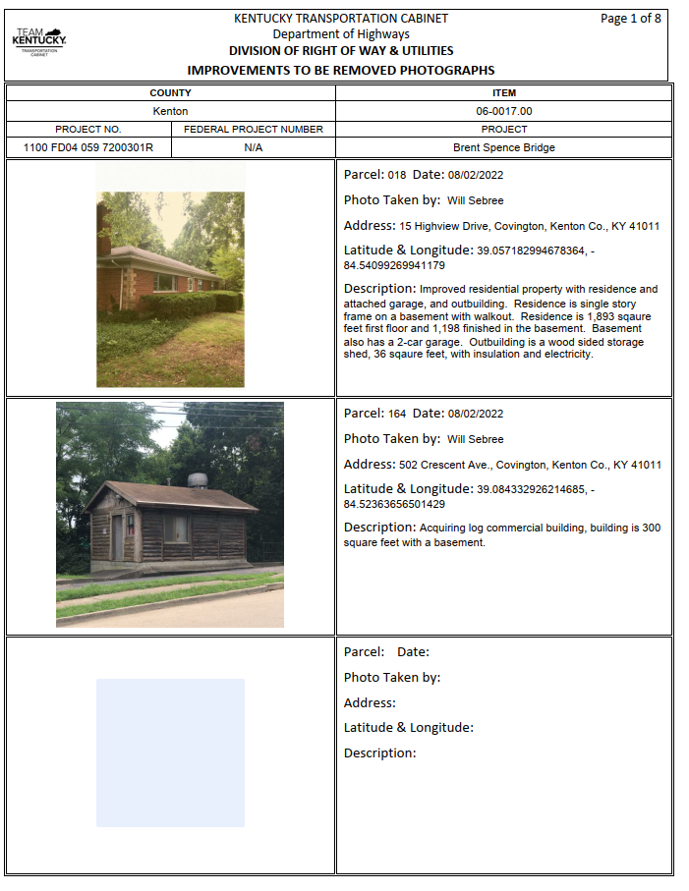
Demolition solicitation

Slide 15
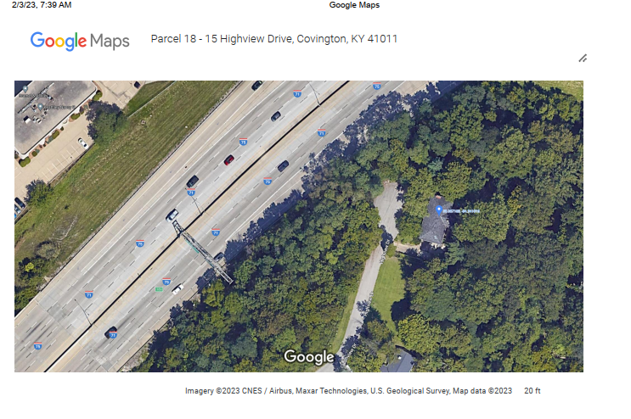
Demolition solicitation

Slide 16
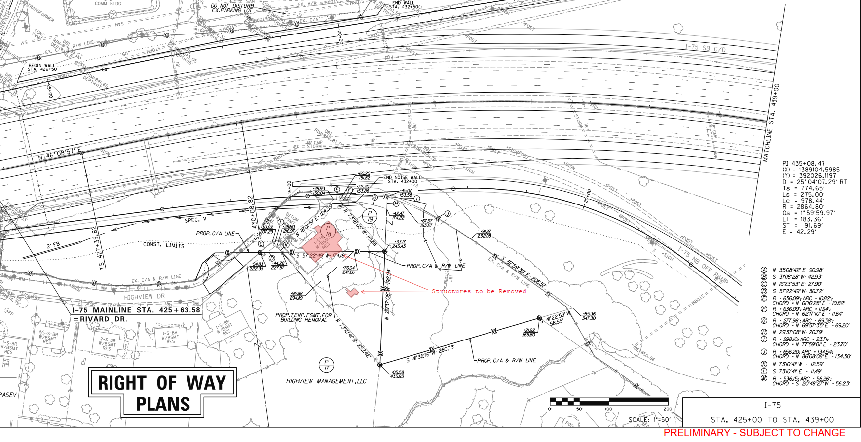
Demolition solicitation

Slide 17
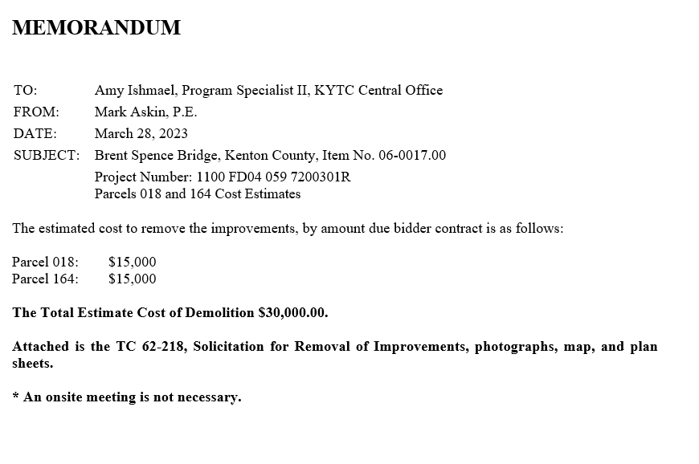
Demolition solicitation

Slide 18
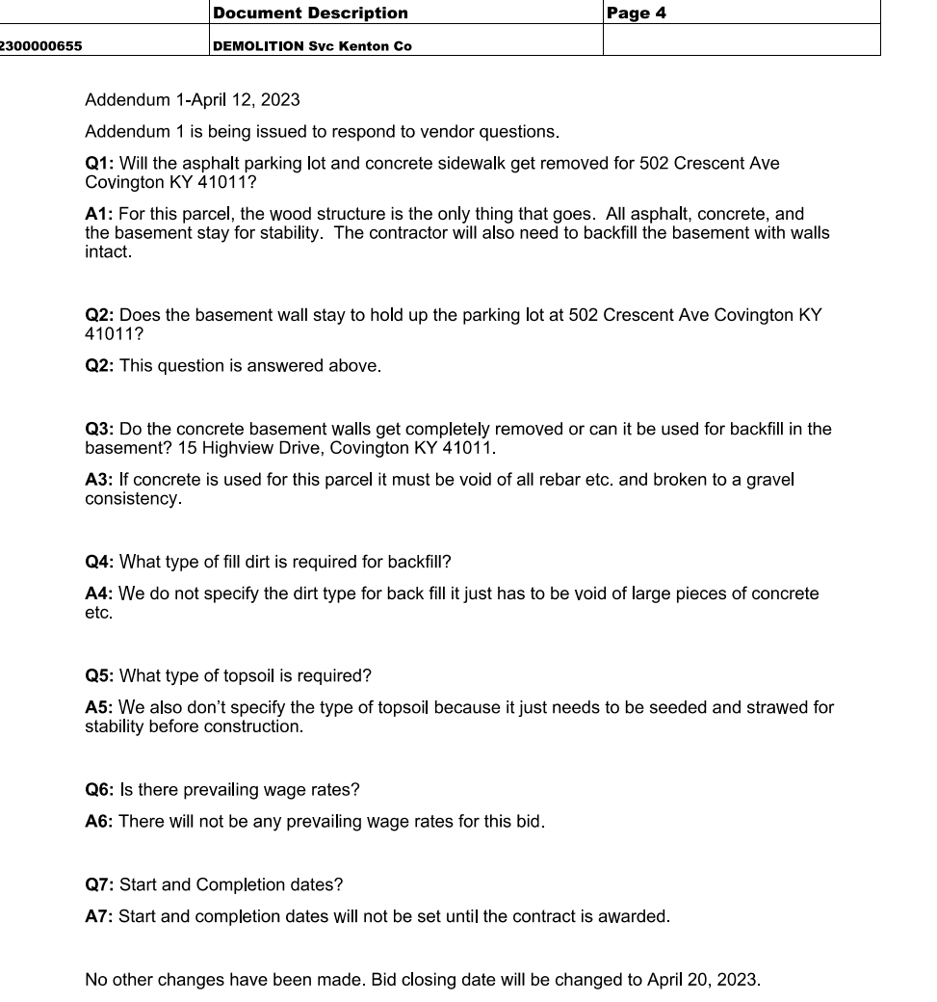
Demolition solicitation
Address questions by bidders with Addendum to solicitation

Slide 19
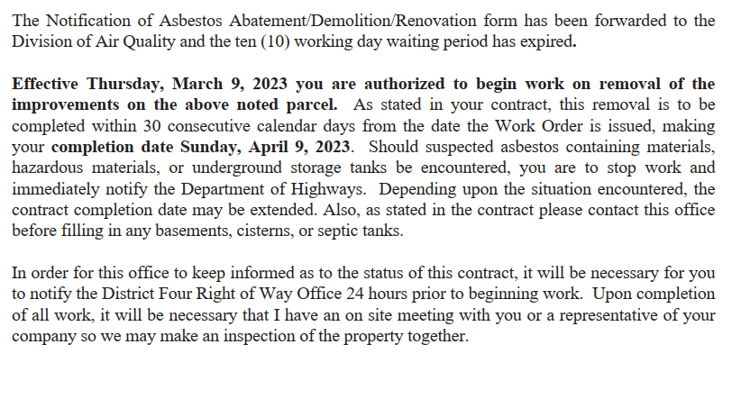
Project is awarded
Consultants cannot approve any bids or compensation – Lesson Learned No. 2
Work order issued to contractor
Must have letter accompanying work order with project dates, etc.
Lesson Learned No. 3 failed to include letter.

Slide 20
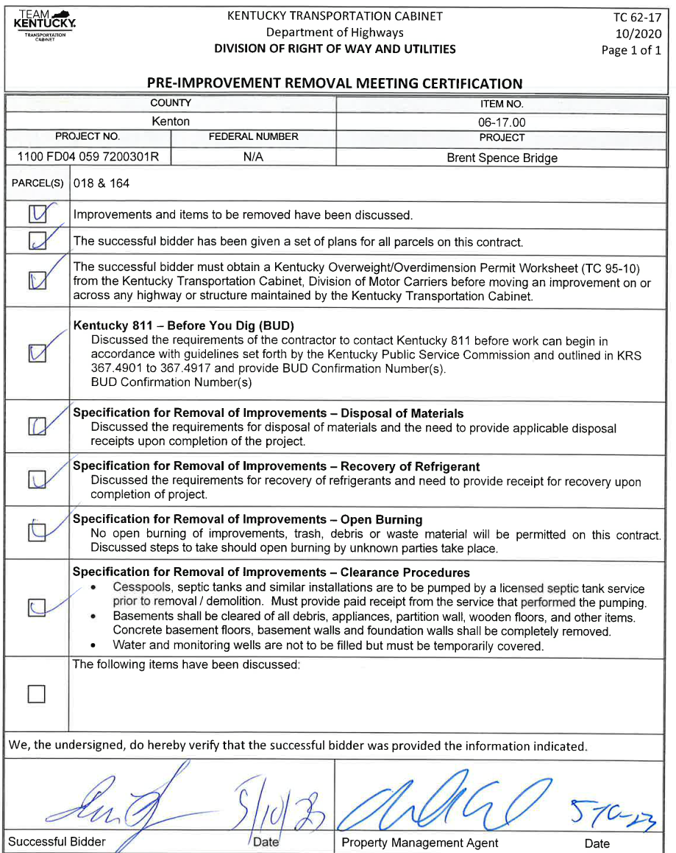
Pre-improvement removal meeting
Meeting with contractor

Slide 21
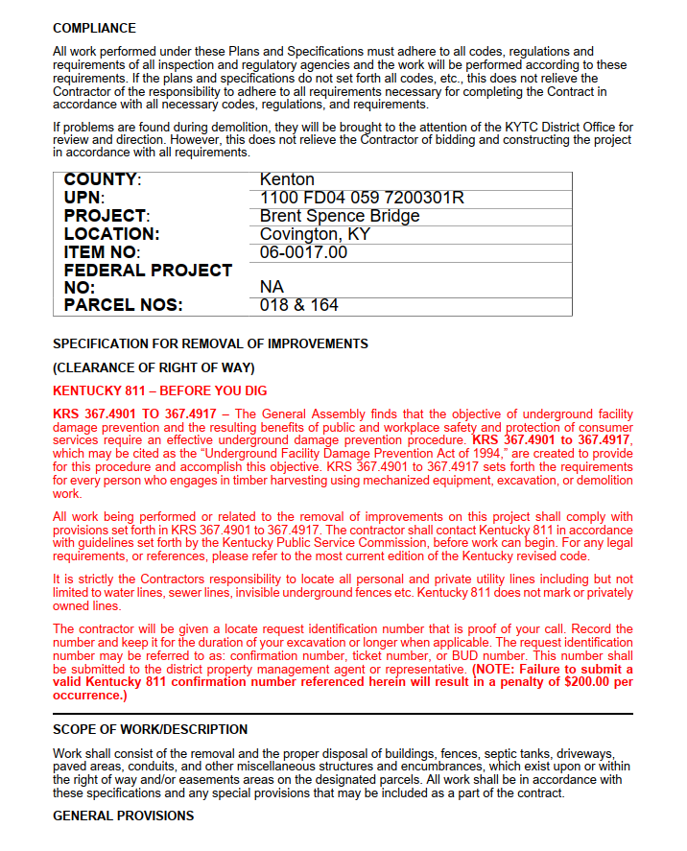
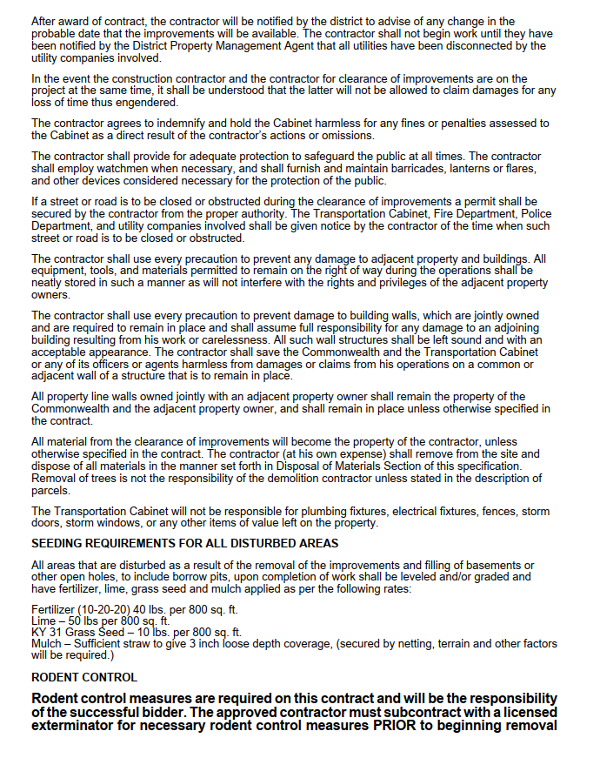
Pre-improvement removal meeting
What are the contractor’s specifications:

Slide 22
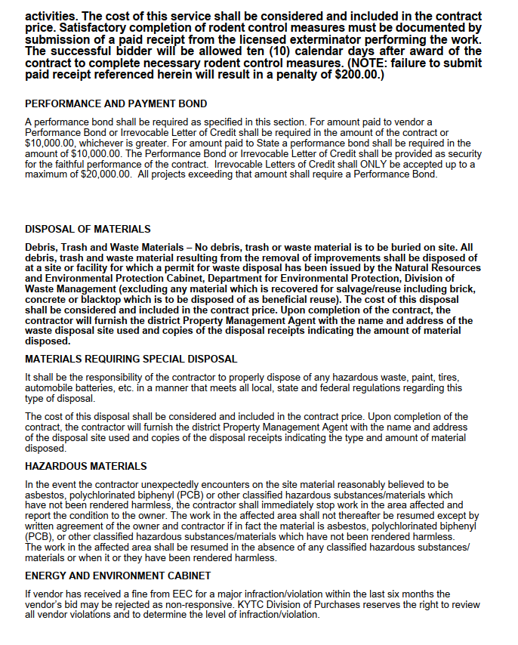
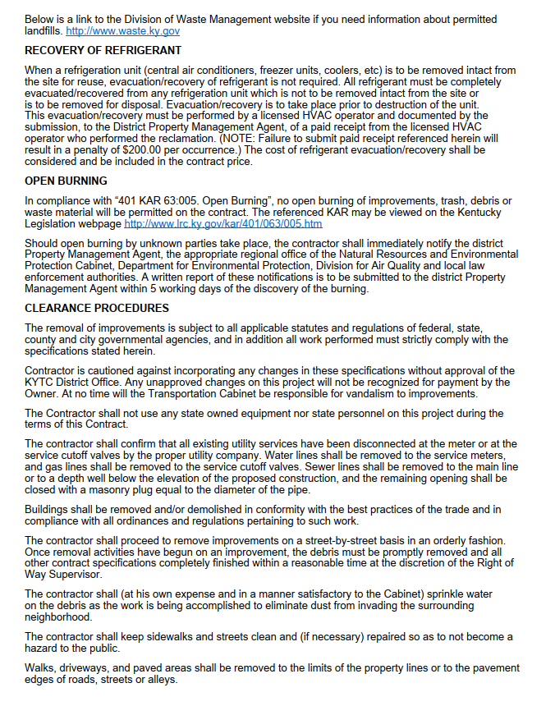
Pre-improvement removal meeting

Slide 23
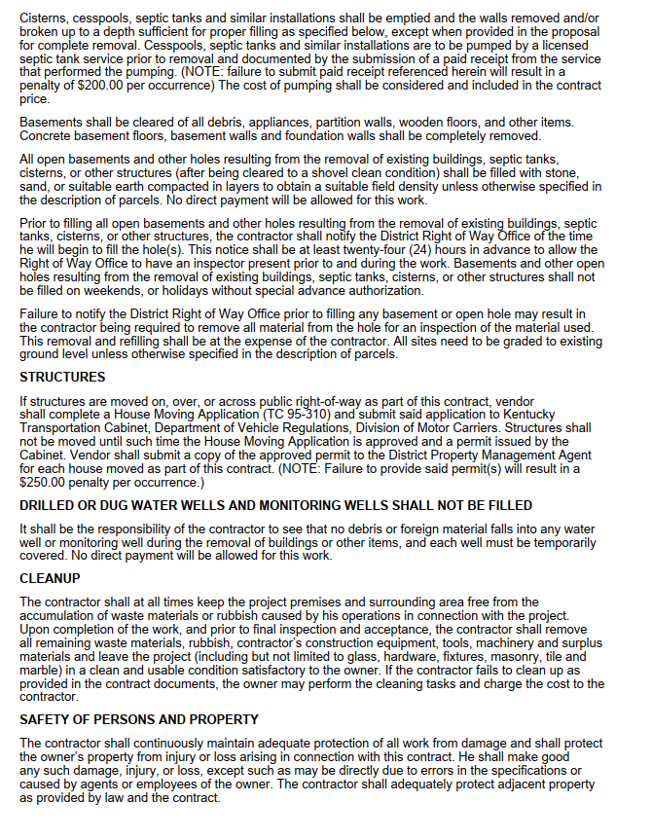
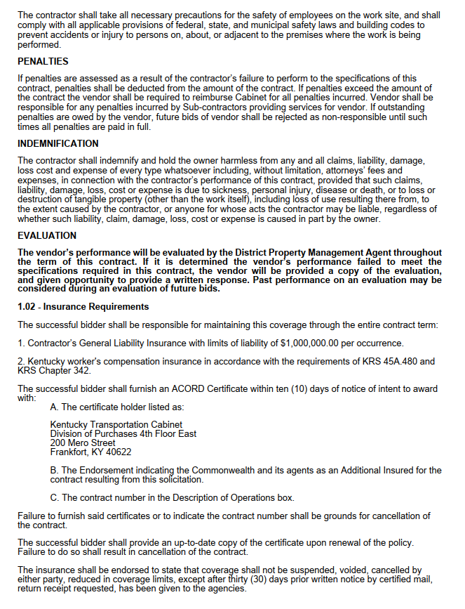
Pre-improvement removal meeting

Slide 24
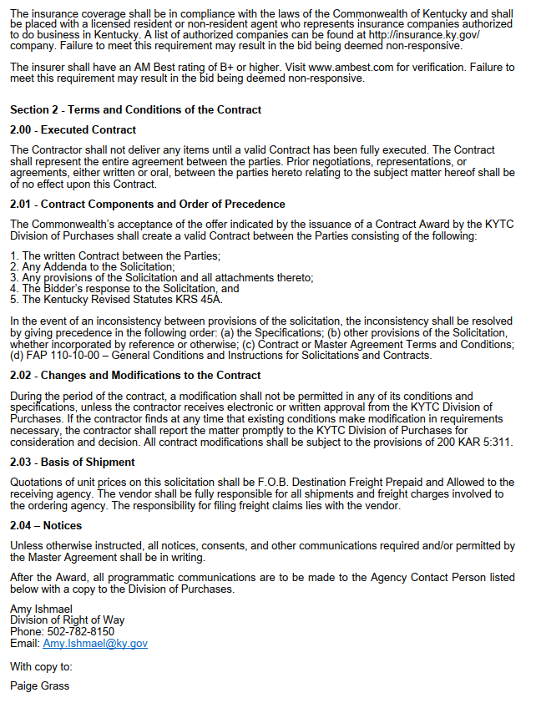
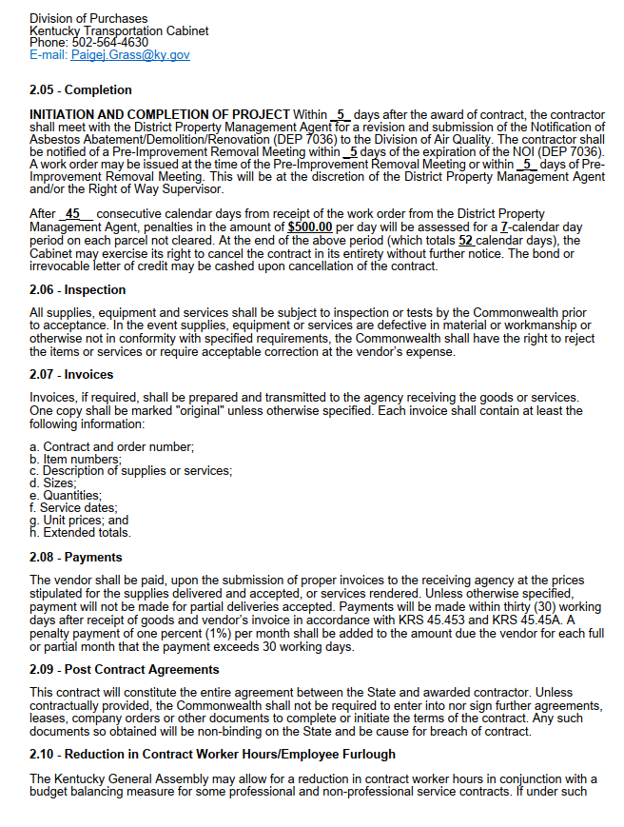
Pre-improvement removal meeting

Slide 25
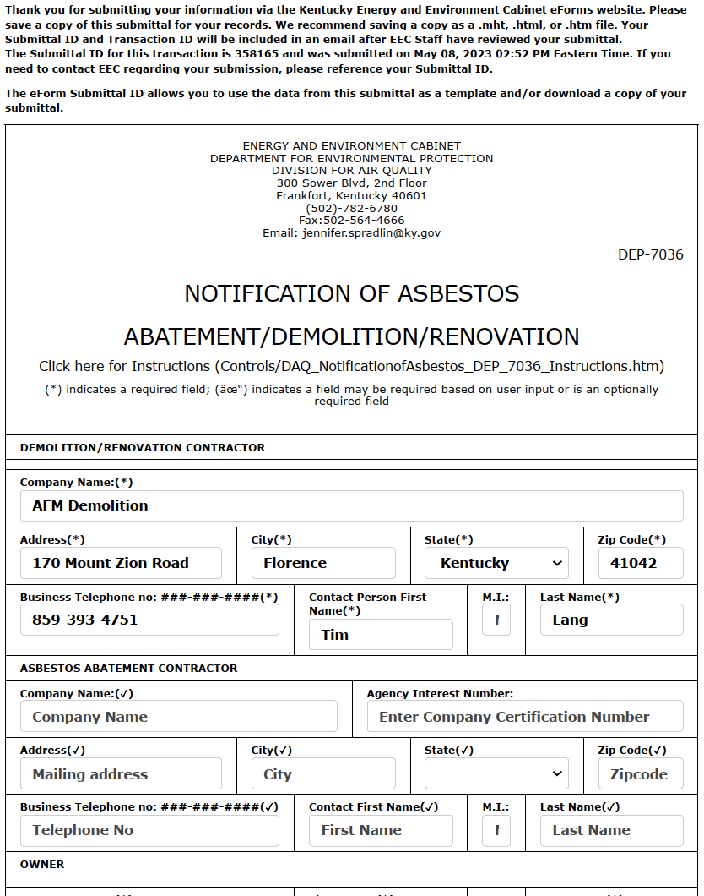
Division of Air Quality submittal
Complete submittal on:
Asbestos Notifications - Kentucky Energy and Environment Cabinet
What is needed?
Contractor’s name and address
Owner’s name
Project location
Contract dates
Waste transporter
Disposal site

Slide 26
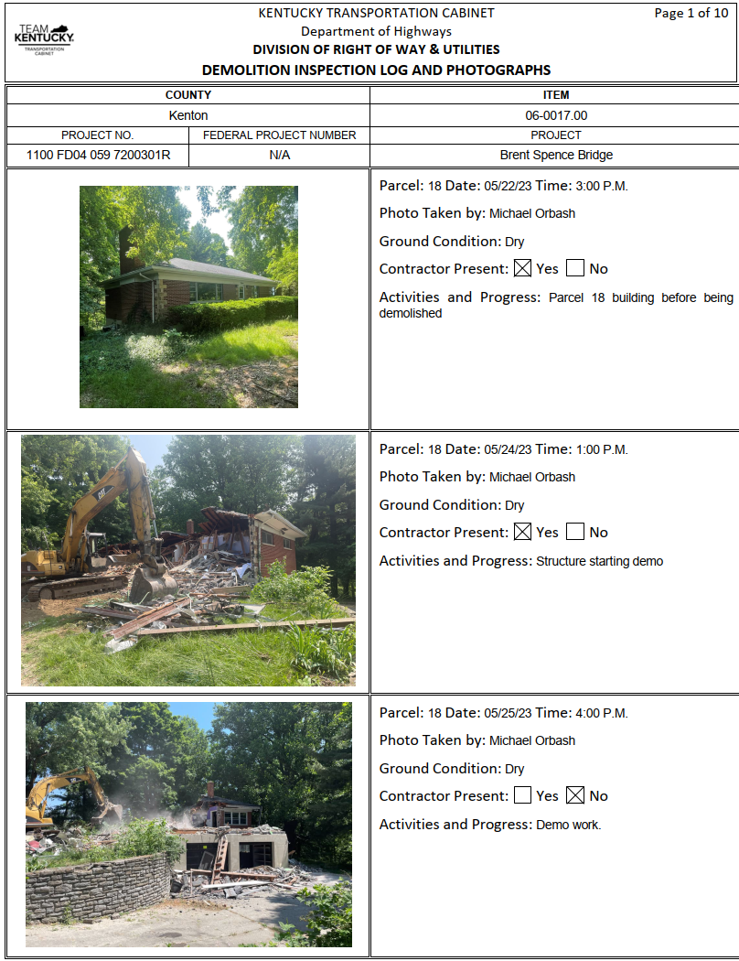
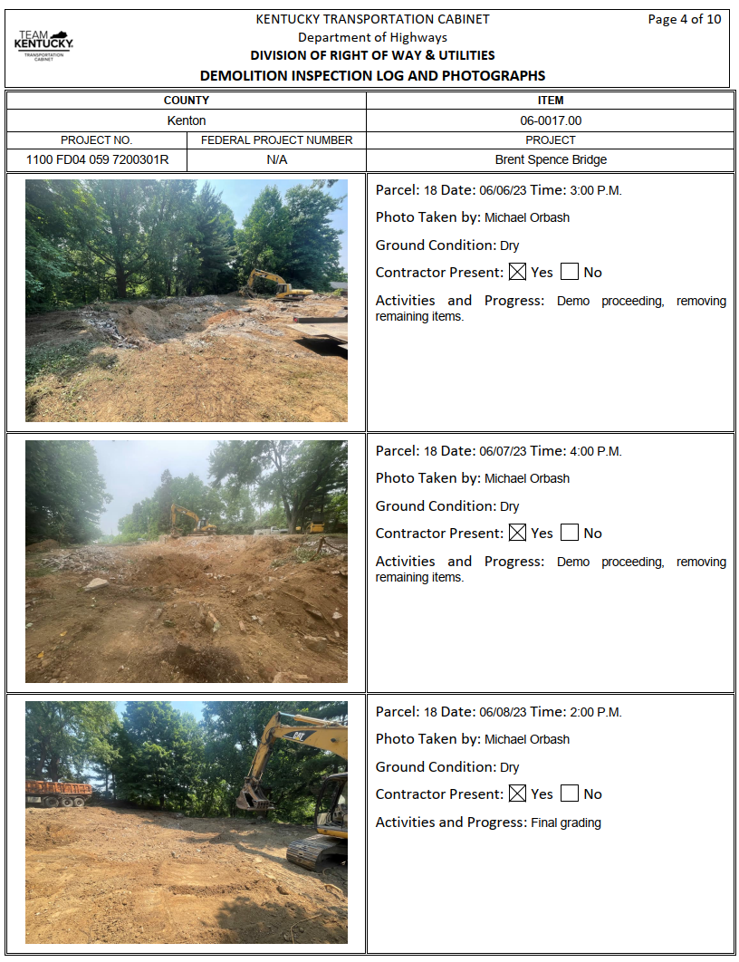
Demolition work begins
Demolition inspection log and photographs

Slide 27
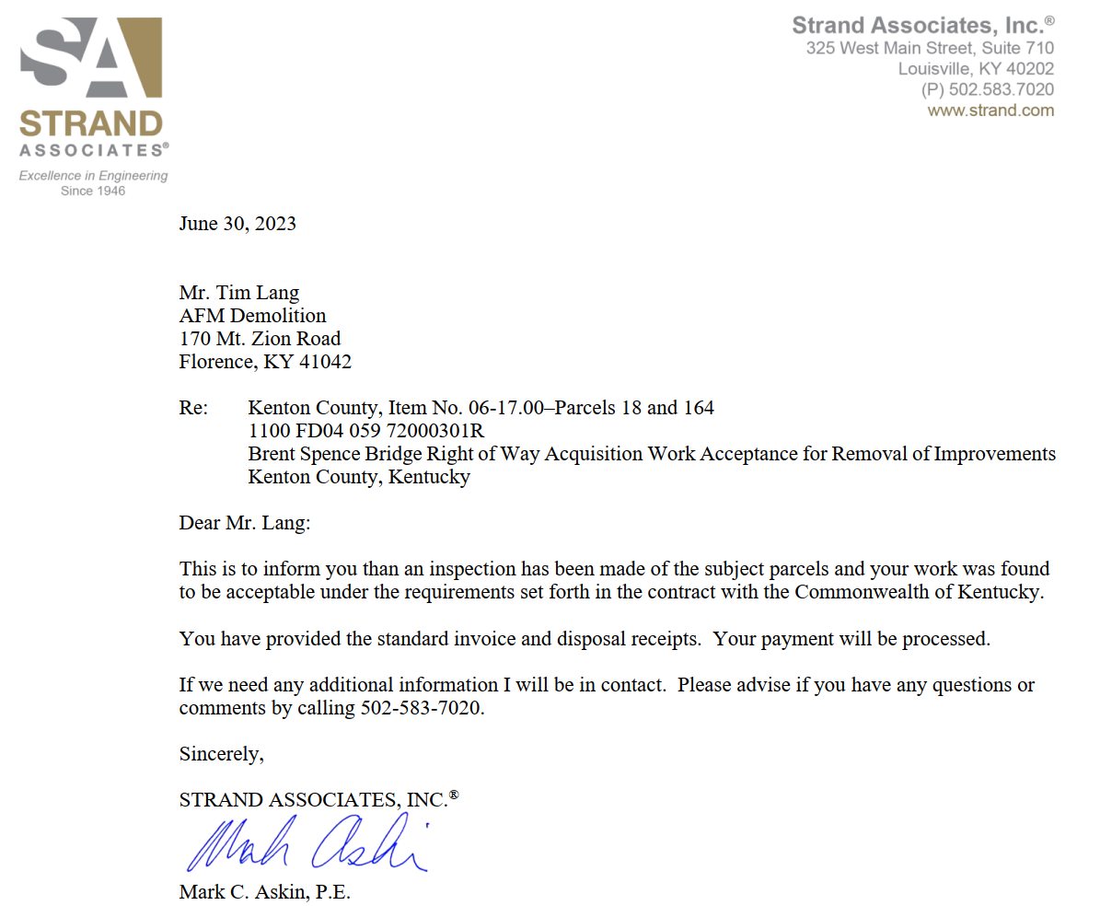
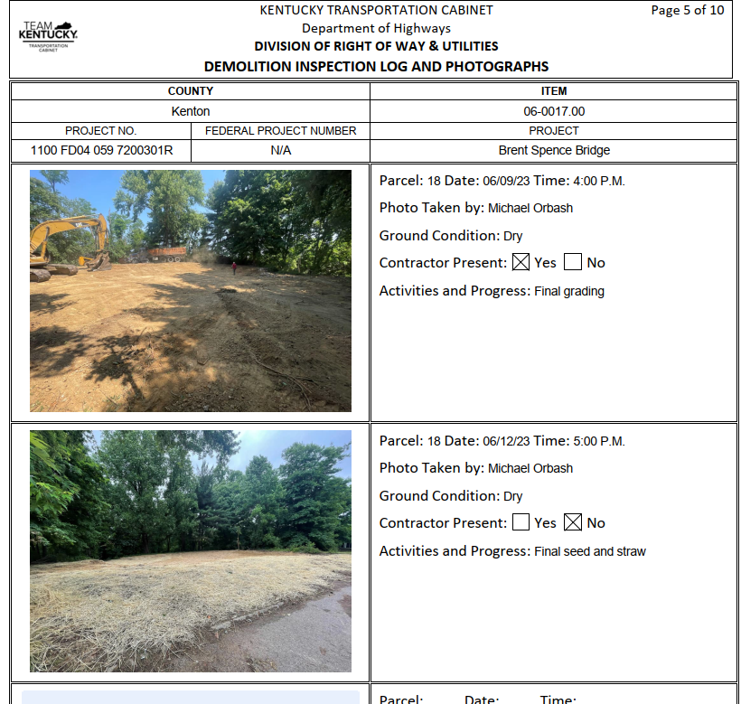
Demolition complete
Work acceptance
Inspection logs
Contractor’s invoice on his letterhead
Updated project summary of improvements
Vendor evaluation

Slide 28
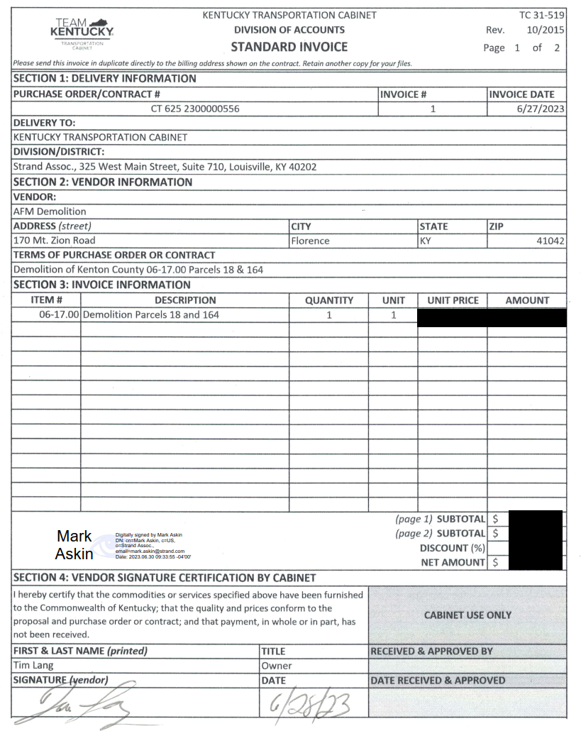
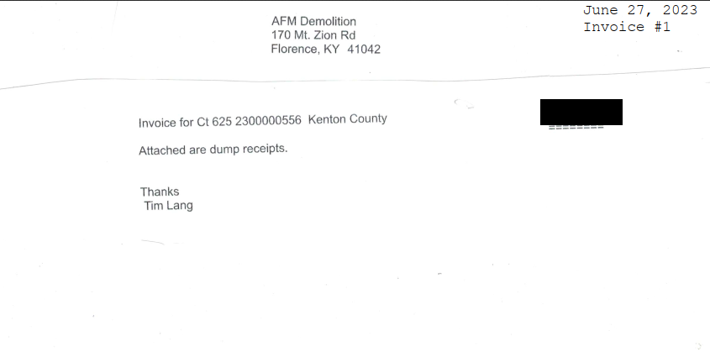
Demolition complete

Slide 29
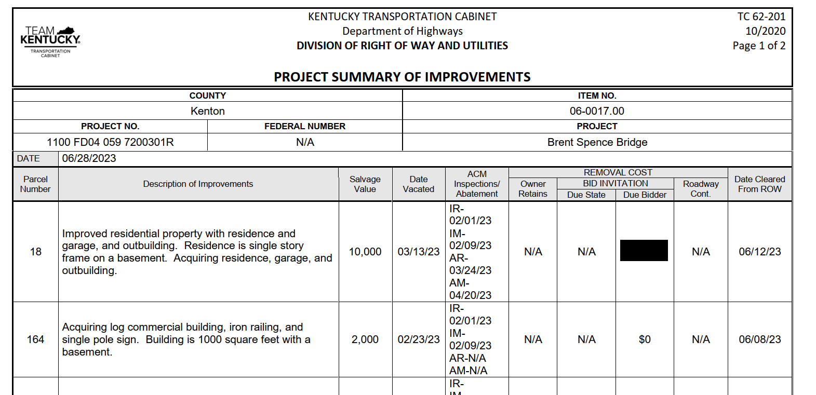
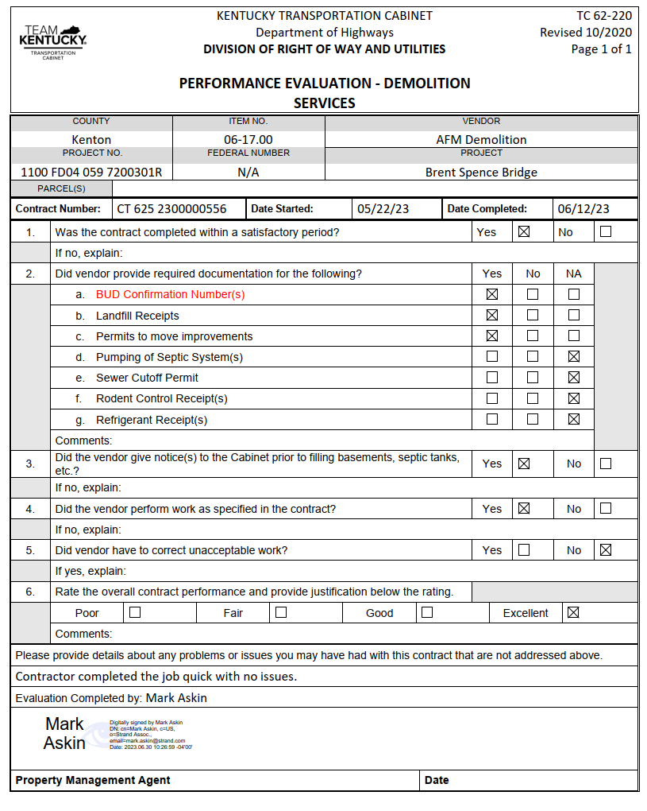
Demolition complete

Slide 30
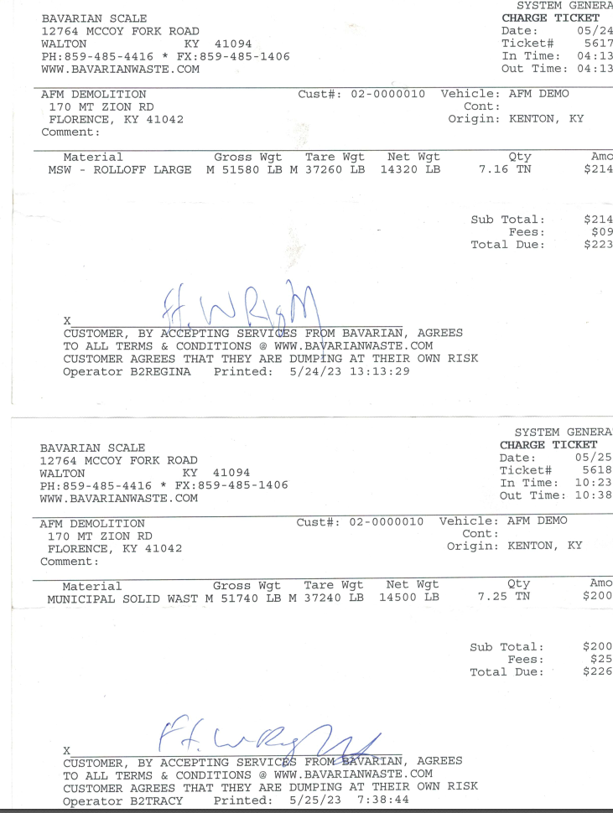
Demolition complete

Slide 31
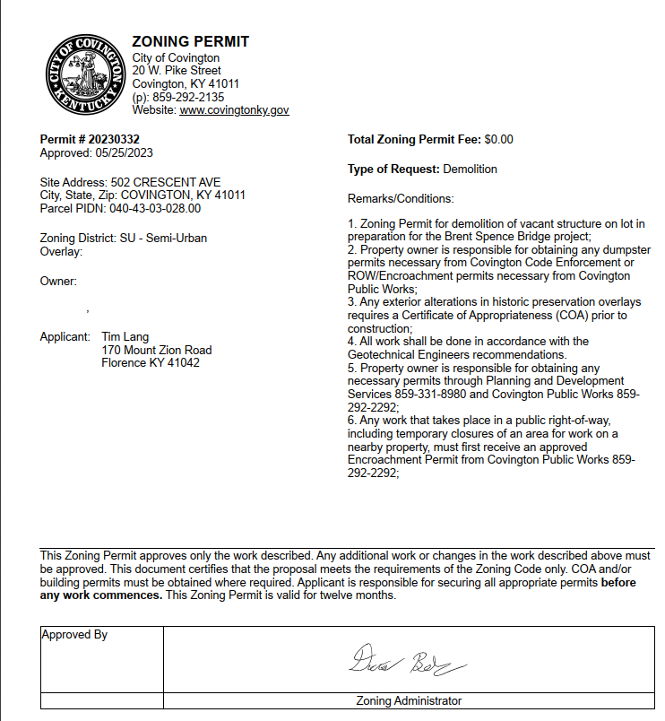
Other Issues
City of Covington required Zoning Permit

Slide 32
Questions?

